Slide 1
What is self-compassion?
Self-compassion practice and discussion group
Fall 2022

Slide 2
What is the goal of self-compassion practice?
To treat ourselves like we would treat a good friend
“To become an inner ally instead of an inner enemy”

Slide 3
Components of self-compassion
Self-kindness
Support and encouragement rather than judgment and criticism
Common humanity
Failure, disappointment and suffering are inevitable
The experience of suffering can connect us rather than lead to isolation
Mindfulness
Cultivating the ability to see and acknowledge our experience
Neither avoiding nor becoming absorbed in suffering

Slide 4
But…
I need to be hard on myself!
To get things done
To succeed
It’s selfish to focus on myself!

Slide 5
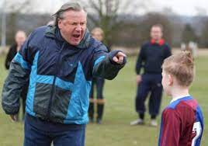
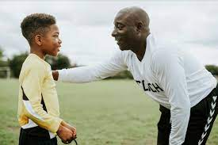
But…
I need to be hard on myself!
To get things done
To succeed
It’s selfish to focus on myself!

Slide 6
Self-compassion ≠ self-esteem
Self-esteem
Based on comparison
Contingent
Self-compassion
Not a judgment but a way of relating to our experience
Always available regardless of conditions

Slide 7
Benefits of self-compassion
Less
Depression
Anxiety
Stress
Shame
More
Happiness
Life satisfaction
Self-confidence
Physical health
For more research on self-compassion (and to take the self-compassion scale), go to
https://self-compassion.org/

Slide 8
Threat versus care
Threat-defense system
Fight, flight, freeze
Stress hormones released
Chronic stress has a negative impact on physical and mental health
Care system
“Attend and befriend”
Oxytocin and endorphins
Downregulates stress response

Slide 9
Stress and self-compassion
Stress Response | Stress Response Turned Inward | Self-Compassion
Fight | Self-criticism | Self-kindness
Flight | Isolation | Common humanity
Freeze | Rumination | Mindfulness

Slide 10
Practice
Affectionate breathing
Grounds us in our present-moment experience with kindness
Self-compassion break
Mindfulness – “This is a moment of suffering.”
Common humanity – “Suffering is a part of life.”
Self-kindness – “May I be kind to myself.”

Slide 11
Discussion
Break-out rooms
Facilitator = student whose first name is closest to “A”
Discussion questions:
What interests you about this topic?
Do you have any experience with meditation?
Are there areas of your life where you notice a lack of self-compassion?
Do you notice that it’s easier to be compassionate to others than to yourself?

