Slide 1
Embracing the good
Self-compassion practice and discussion group
Fall 2022

Slide 2
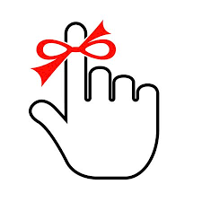
Reminders
The goal of self-compassion practice is to treat ourselves like we would treat a good friend.
The components of self-compassion are mindfulness, common humanity, and mindfulness.
Self-compassion invites us to use encouragement rather than judgment as motivation.
Cultivating compassion for ourselves helps us offer compassion to others.

Slide 3
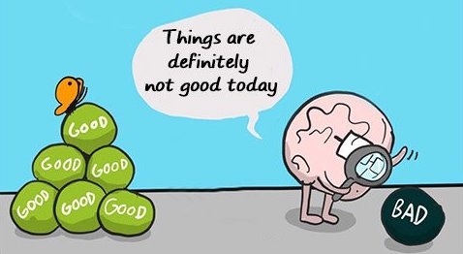
Negativity bias
Focusing on the negative makes evolutionary sense
Problems
Discrepancies
The brain is “Velcro for bad experiences and Teflon for good ones” (Rick Hanson)
How does your negativity bias distort reality?
Notes:
My bias – student statements (evaluations); puppy raising

Slide 4
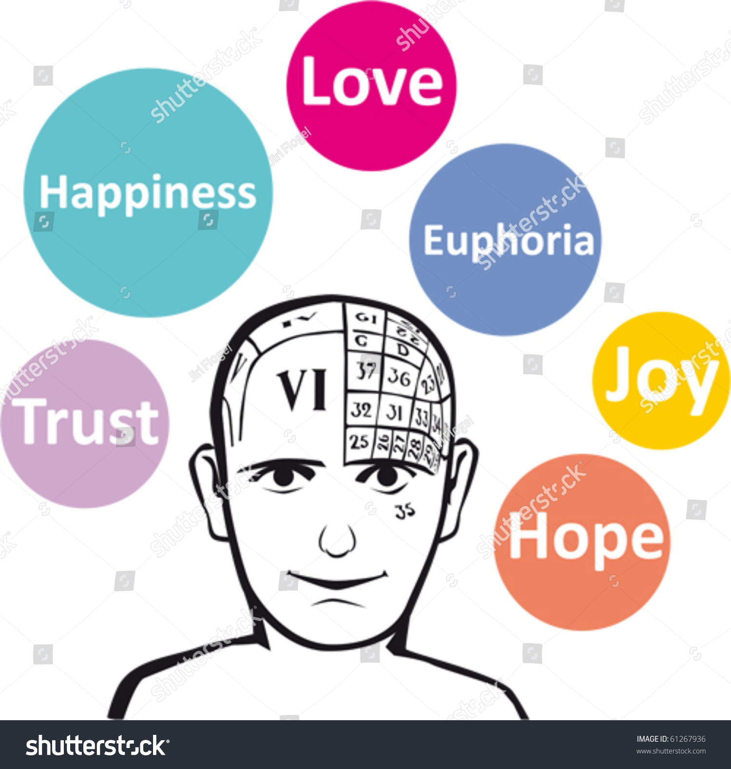
Broaden-and-build theory
Positive emotions broaden attention
Support curiosity and exploration
Joy → play
Interest → exploration
Contentment → savoring, integration
“Positive emotions promote discovery of novel and creative actions, ideas and social bonds, which in turn build that individual’s personal resources.”
Barbara L. Fredrickson (2004)

Slide 6
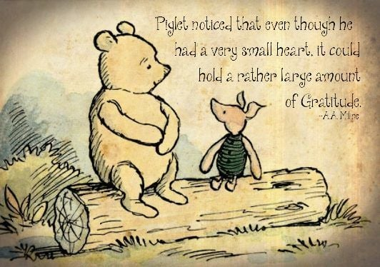
Cultivating awareness of the positive
Savoring
“Being aware that something good is happening while it’s happening.”
(Experiential practice)
Gratitude
Focusing on what we do have
(Wisdom practice)

Slide 7
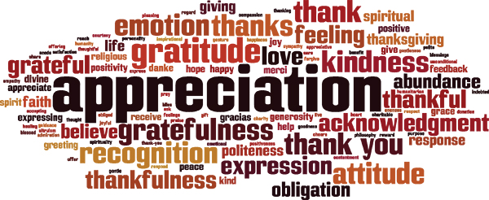
Cultivating self-appreciation
NOT self-esteem (better than others)
NOT pretending that everything is perfect
Recognizing that we have good qualities
Part of our common humanity

Slide 8
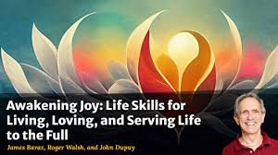
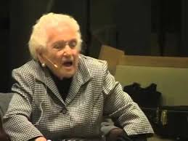
Changing from “but” to “and”
James Baraz and his mother (p. 162)
“Confessions of a Jewish Mother: How My Son Ruined My Life!”
“…And my life is very blessed”

Slide 9
Practice
Gratitude
Self-appreciation (p. 171)

Slide 10
Discussion
Facilitator = student whose last name is closest to “z”
Discussion questions:
In what situations is it easy for you to savor the moment? In what situations do you notice that you focus on the negative?
Are you good at giving compliments to other people? Are you good at receiving compliments?
Are you aware of any of your personal qualities that can be framed as either positive or negative? For example, someone could be described as either “organized” or “rigid”.

