Slide 1

History Courses
Fall 2024

Slide 2
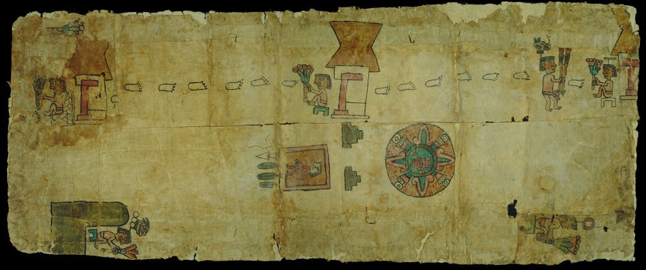
HIST 233: Colonial Latin America
Prof. Ablard M 1:00 – 1:50 & TR 10:50 – 12:05

Slide 3
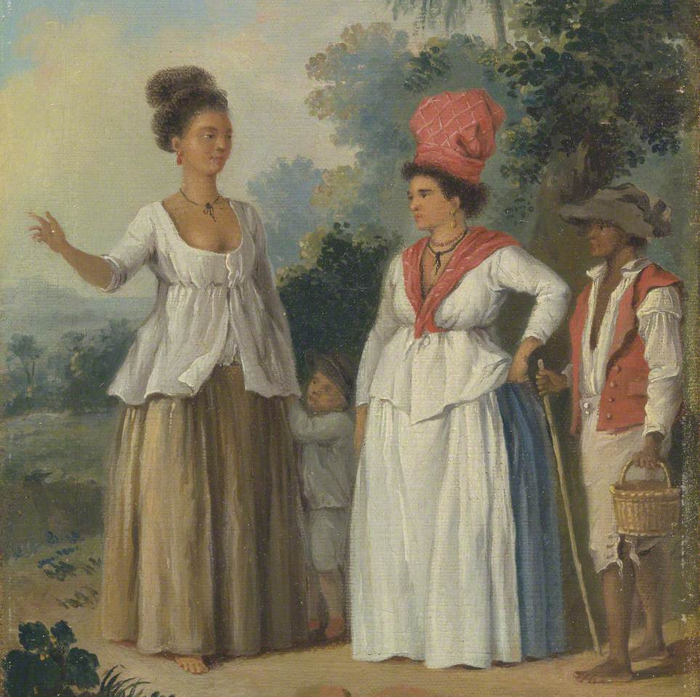
Caribbean History: Race, Gender, and Class
Professor Ablard
HIST 288
MW 4-5:40pm

Slide 4
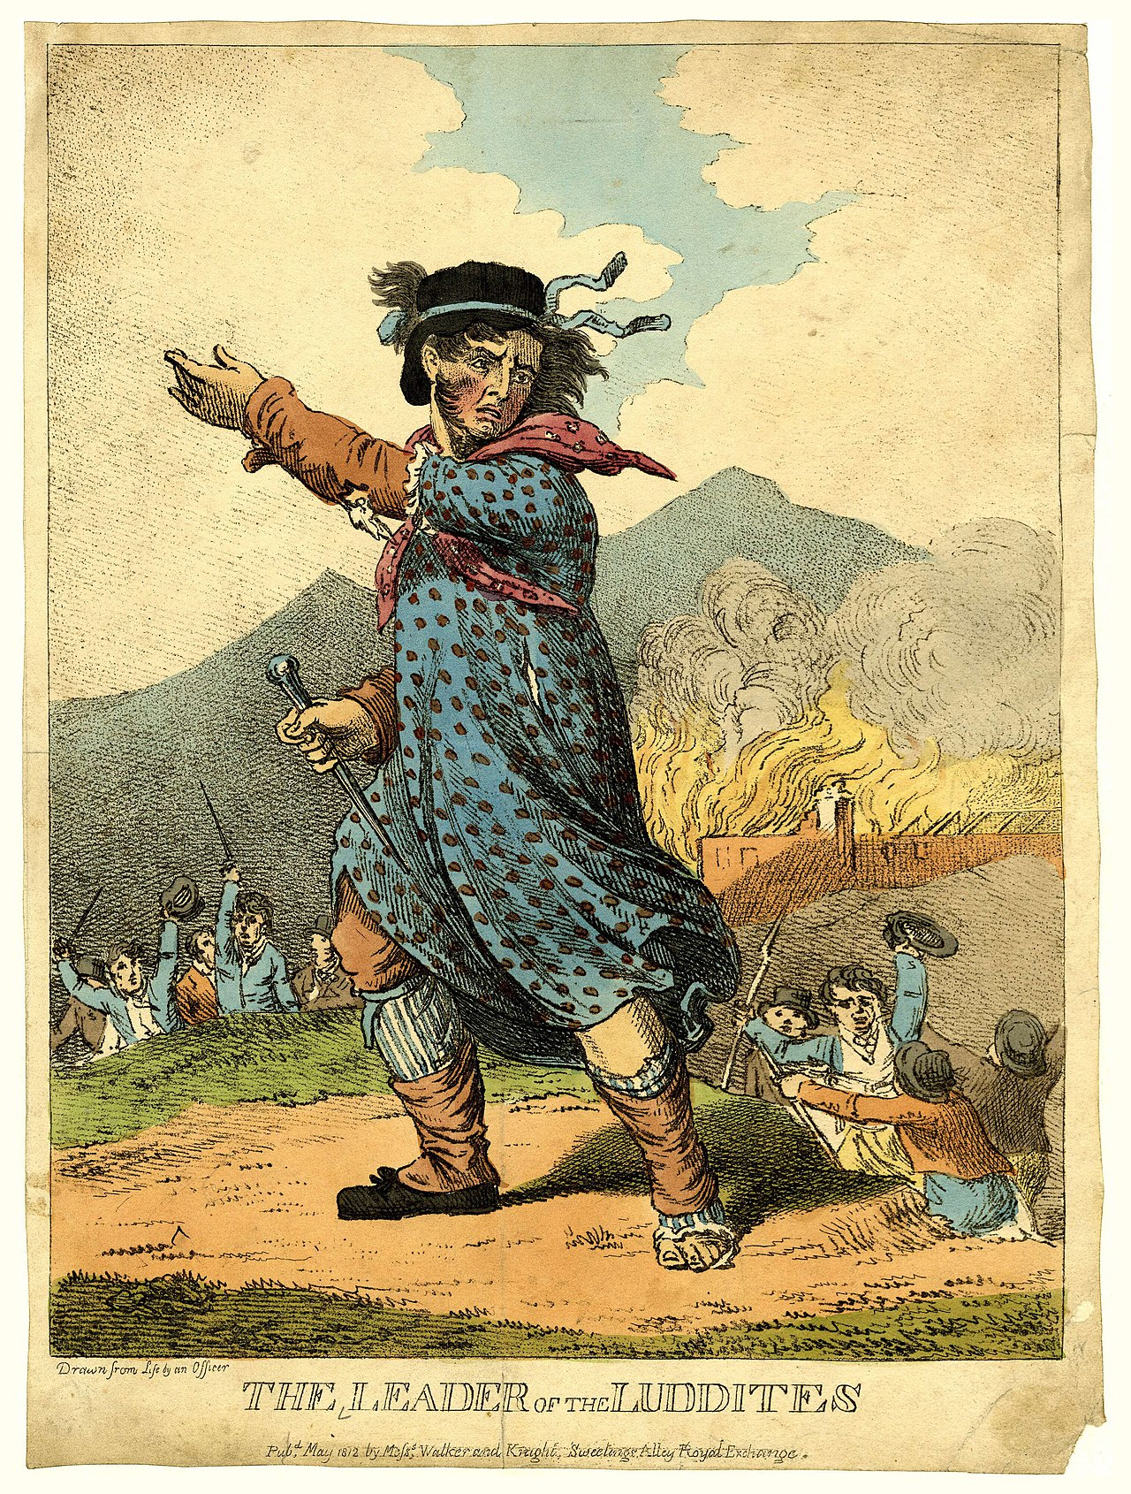
History 141
From the Margins: European Social History, 1400-1945
Prof. Karin Breuer
MWF 9:00-10:10
This course traces the history of minority and marginal groups in Europe from the Renaissance to the end of the Second World War. It carries a diversity designation for the ICC.

Slide 5
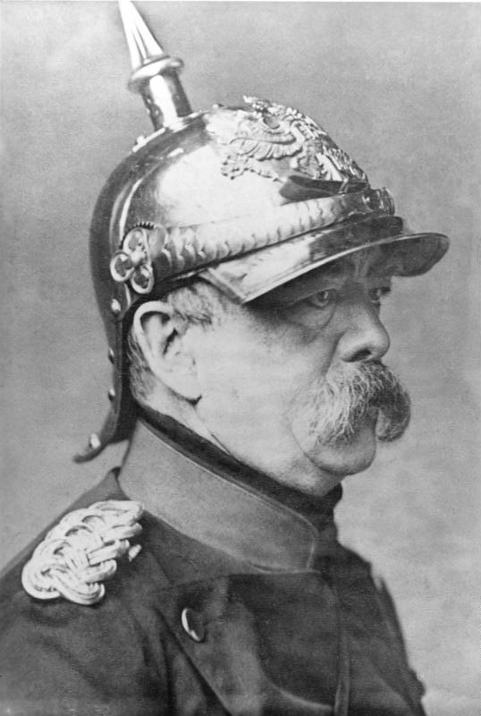
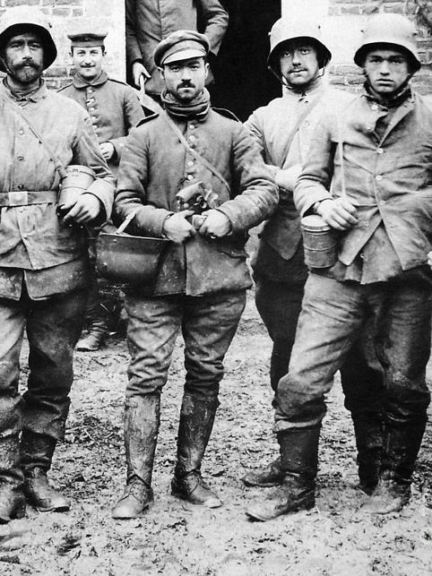
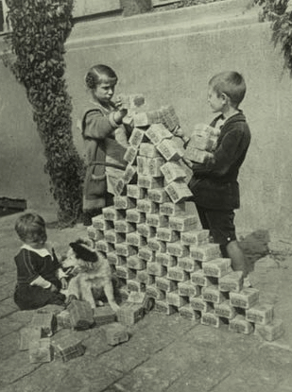
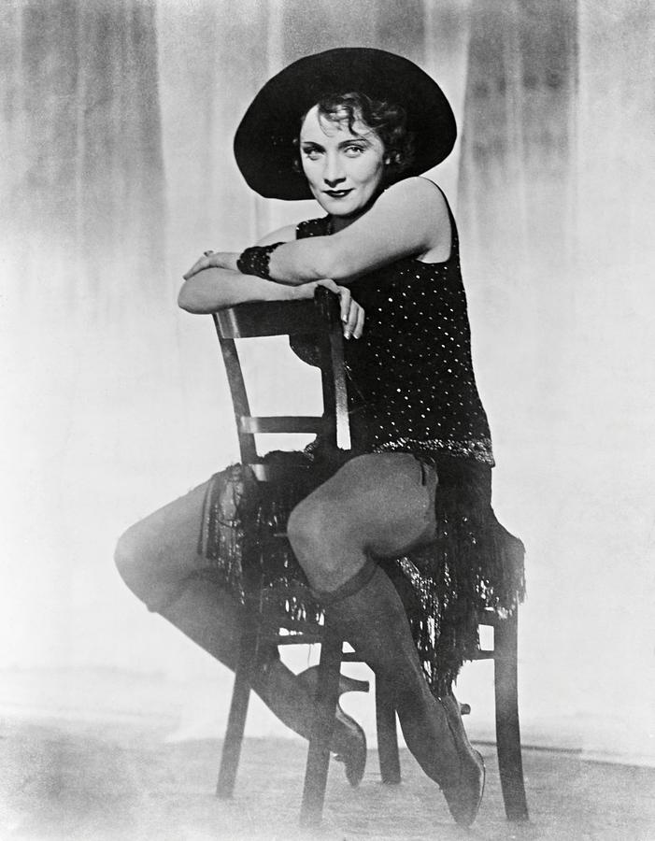

HIST 35400:
Imperial and Weimar Germany, aka “How Democracies Die”
MWF, 2:00-2:50

Slide 6
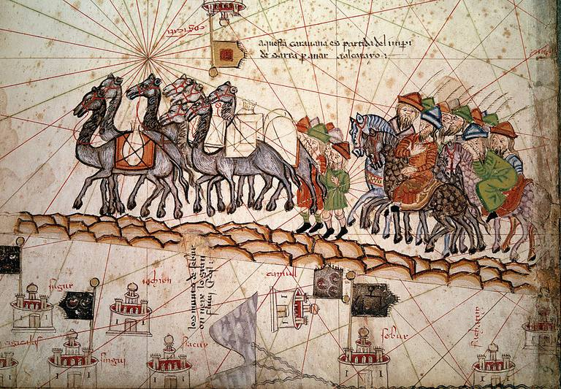
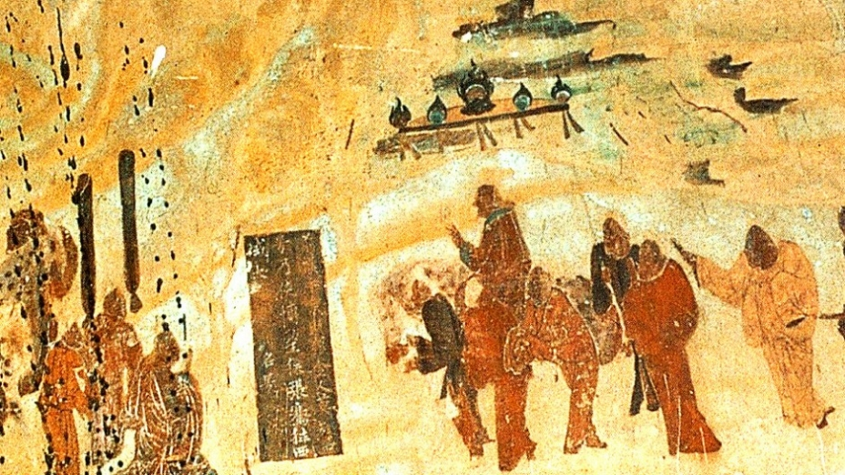
History 181: Becoming Global: The World to 1500
Prof. Jason Freitag
TR 9:25-10:40 am and W 3:00 – 3:50 pm
This course covers the emergence and development of world civilizations from prehistoric times to approximately 1500 CE. Students will become familiar with the development of and interactions between peoples, states, civilizations, and empires. A few themes include: the evolution of different socio-political organizations, cultural encounters in various forms, gender and family, and the development of intellectual ideas and world religions.

Slide 7
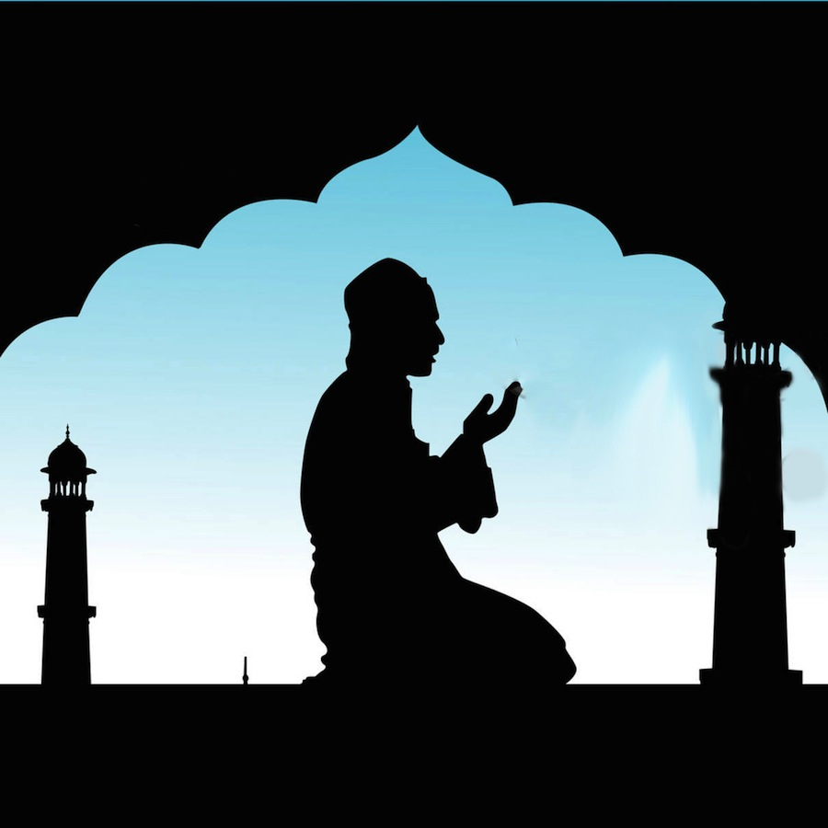
History 227
Early Islam
TR 4:00-5:40 PM
This course deals with the worldwide development of Islamic societies, beginning in the Arabian Peninsula just before the time of Muhammad. The course then considers the rise and consolidation of Islam in Arabia, and follows the global development and impact of Islamic societies as they become established from Europe to India and Southeast Asia.

Slide 8
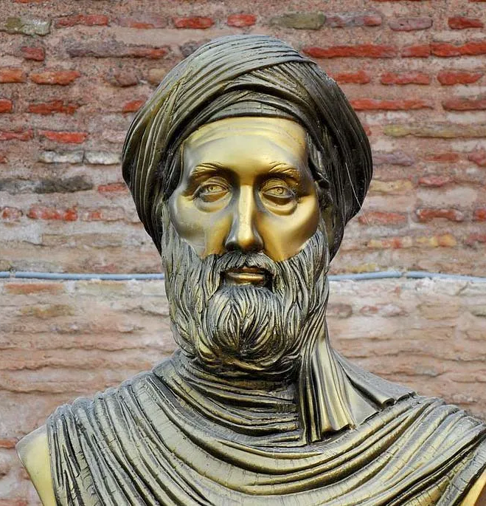
HIST 450 Seminar and Capstone:
How the World Does History
This class will explore the nature of historical work across a broad range of cultures and time periods. Our objective is to identify and understand the many ways that other cultures have, and in some cases still do, construct and understand their past. We will examine the role of bards in cultural history, lineage as a vision of the past, the epic as history, and cyclical thinking as a representation of temporal consciousness. Texts include Herodotus’ The Histories, South Asian poetic texts, the Muqaddimah of Ibn Khaldun and Cheikh Anta Diop’s The African Origin of Civilization: Myth or Reality.
The course also provides a capstone experience for History Majors. Students will reflect upon their learning and connect their undergraduate work to the paths they will take after graduation

Slide 9
Attention all History Majors: Scholarships Available!!!
What: Money ($$$$) towards your tuition (To be eligible, you must be a History major planning to continue
at Ithaca College as an undergraduate student and History major during the 2023–2024 Academic Year, and you
must have a 3.0 GPA overall & in your history classes.)
How: E-mail a portfolio of 3 history papers and a cover letter detailing how these papers
best represent your work as a history student to Professor Freitag
(jfreitag@ithaca.edu).
When: by Wednesday, March 29, 2024
See the History Department Student Awards and
Funding webpage for more information.

Slide 10
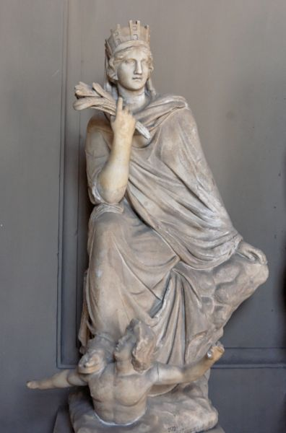
History 101: Before Europe: Cultures of the Premodern West
Prof. Klemm
TR 2:35-3:50
This course examines a selection of cultures from the beginnings of Western civilization in ancient Greece into the sixteenth century.
This course also has two ICC designations: Power and Justice and Identities.

Slide 11
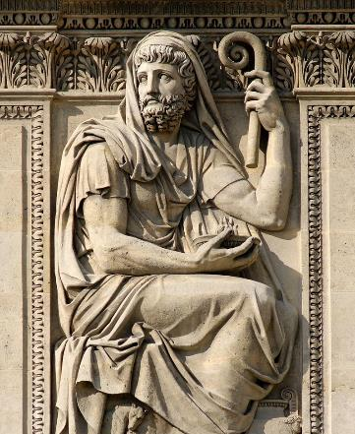
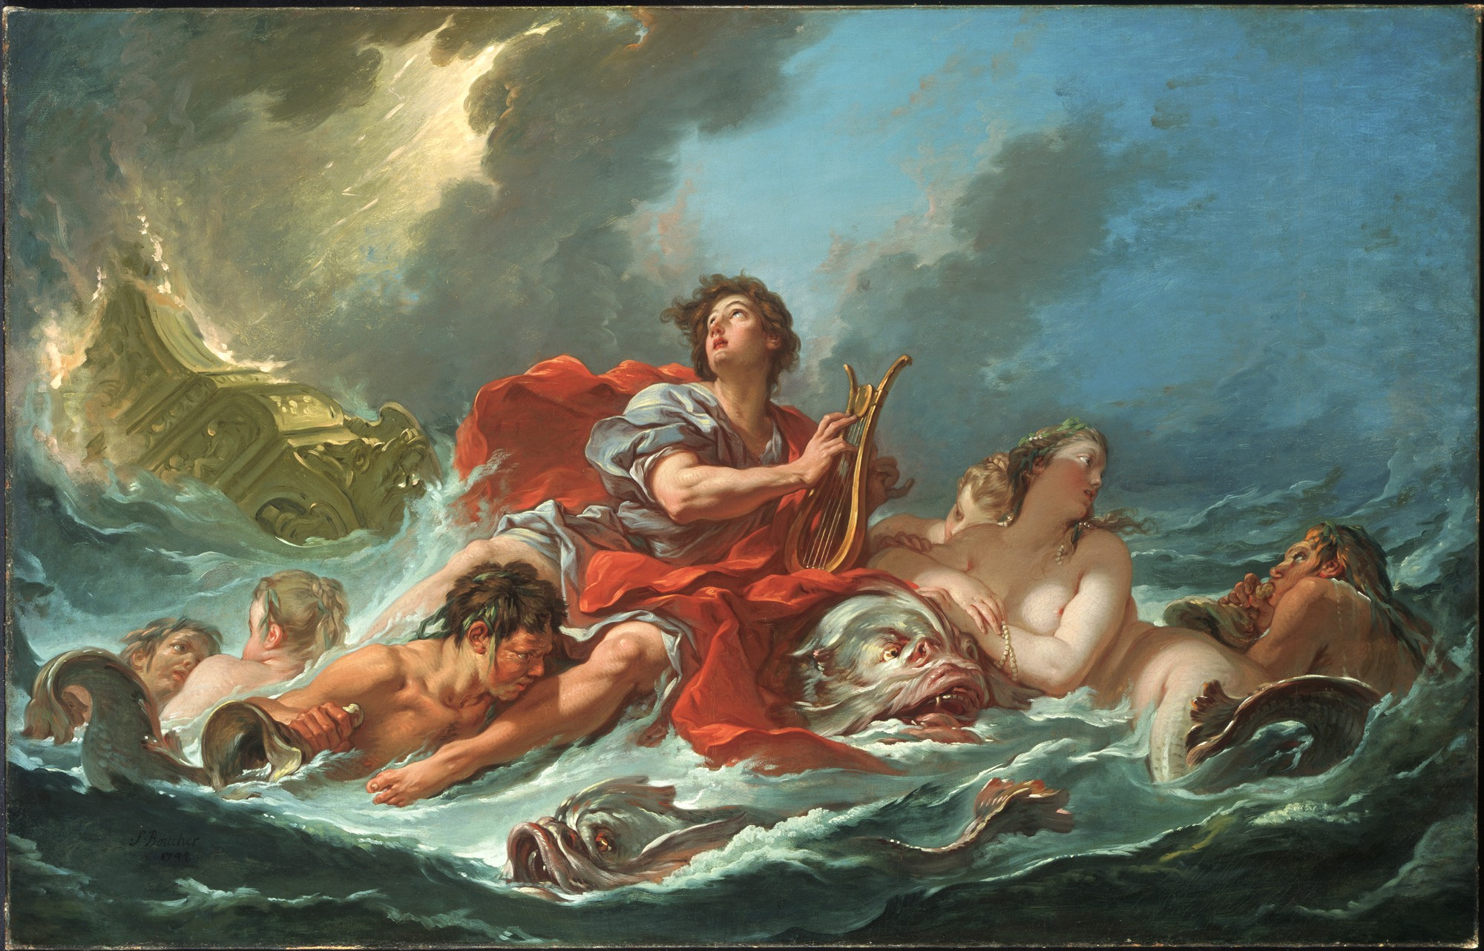
Ancient Historians: Herodotus
HIST 20001-01
1 CR
Wednesdays: 11:00-11:50
Professor Klemm
Herodotus' History, most famous for the story of the Persian Wars, is a remarkable treasury of incredible stories, which have inspired countless moments in fantasy and historical fiction over the years. This 1-credit class will read and discuss selections from this text, while also considering the significance of the History as a new genre in 5th-century BC Greece.

Slide 12
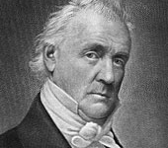
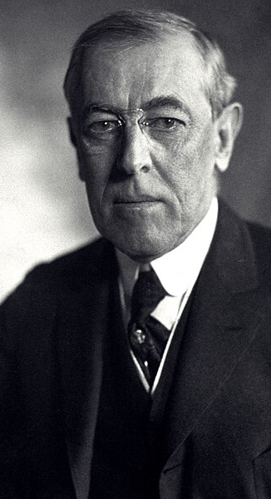


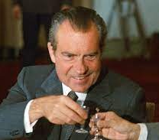
History 15000: Best & Worst Presidents
Professor Ponce
MWF 2:00-3:10

Slide 13
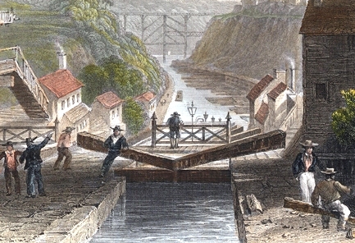
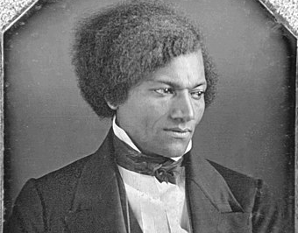
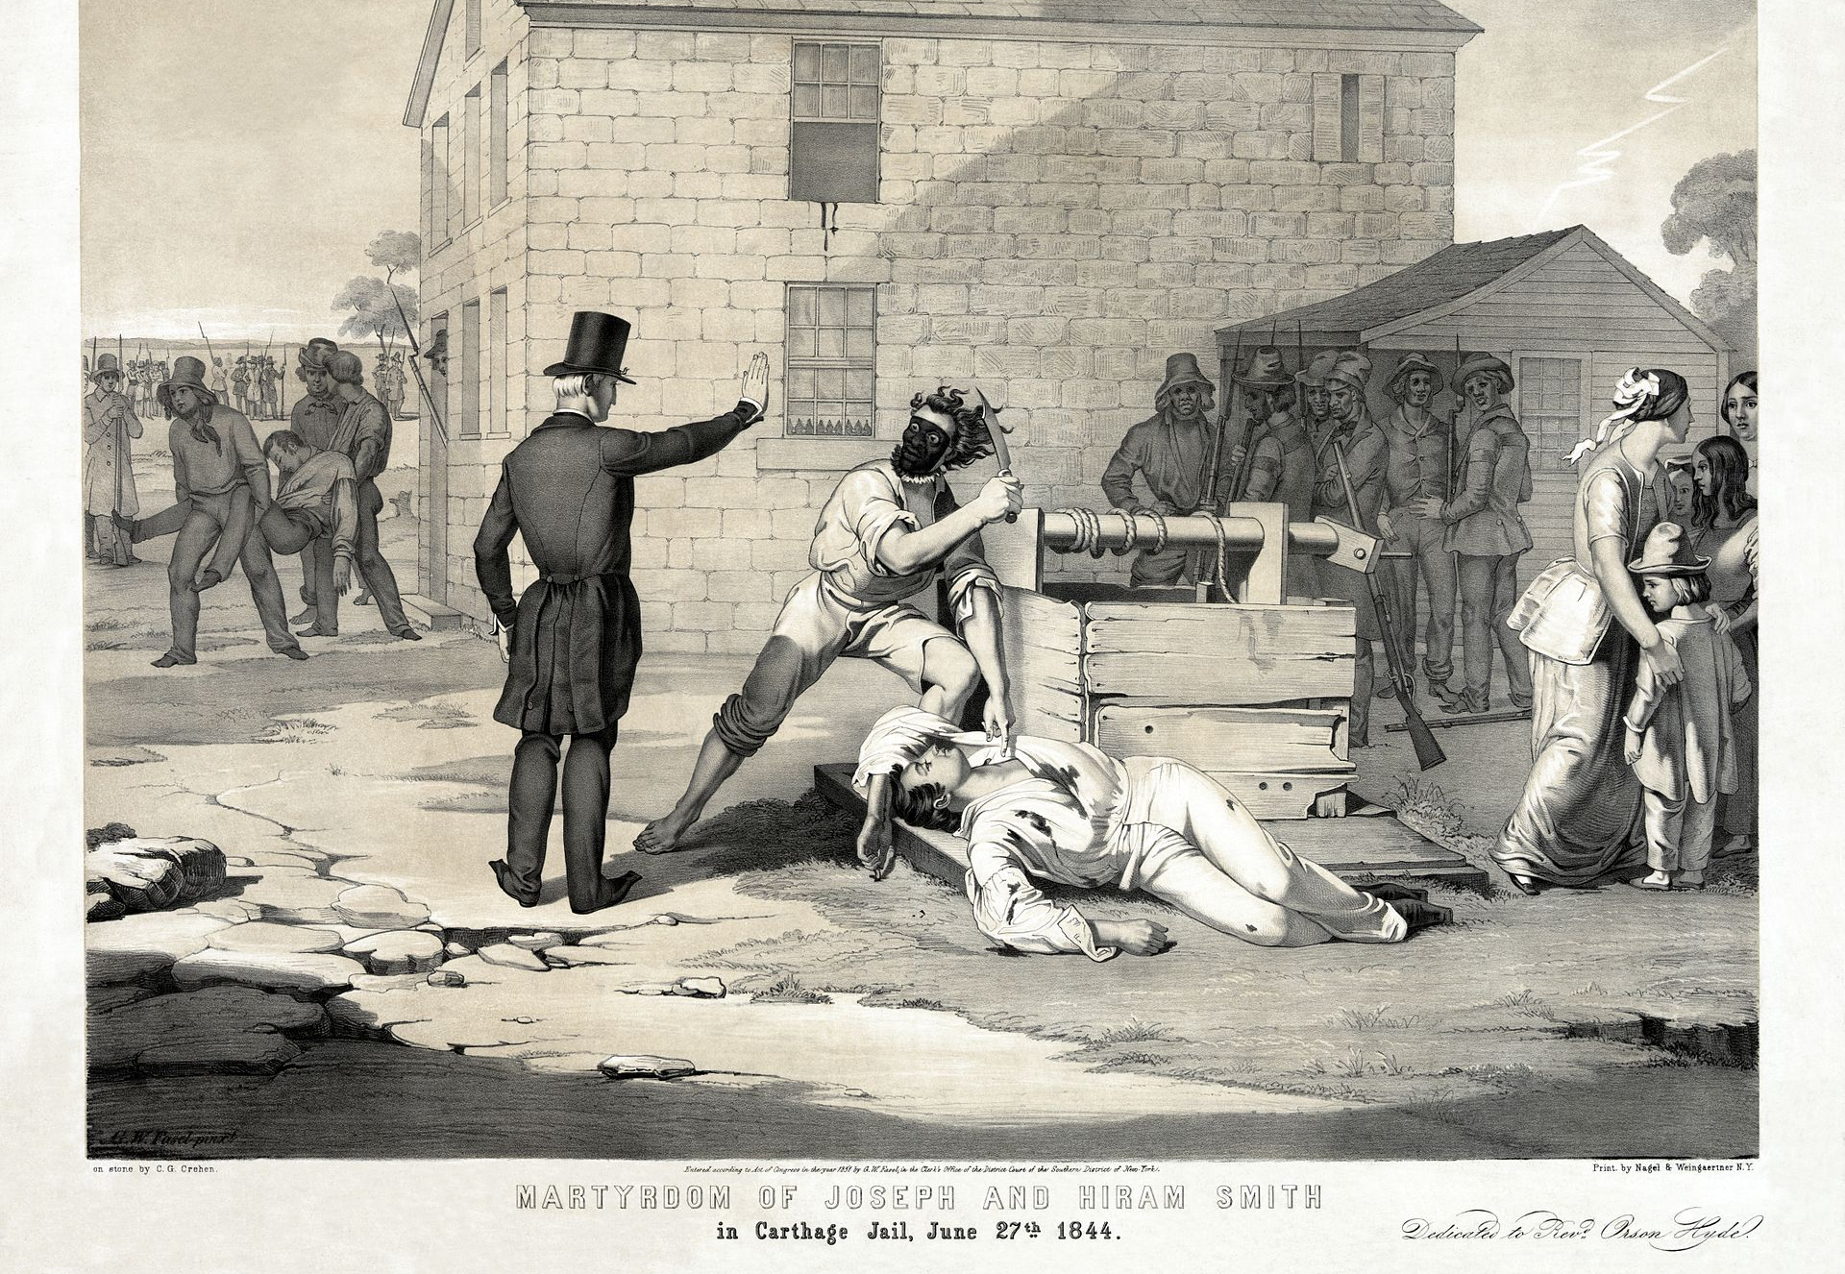
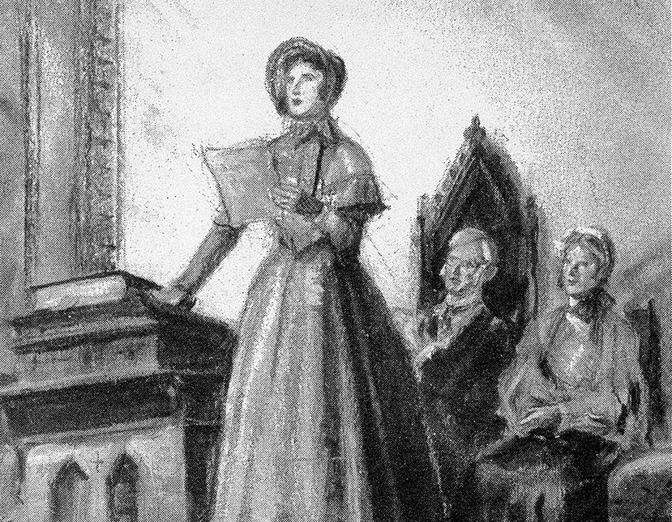
History 240: Reimagining America: Politics, Religion, and Reform in the Antebellum U.S., 1815-1860
Prof. Ponce
MWF 11:00-12:10

Slide 14
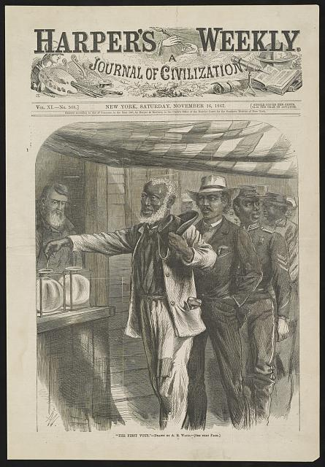
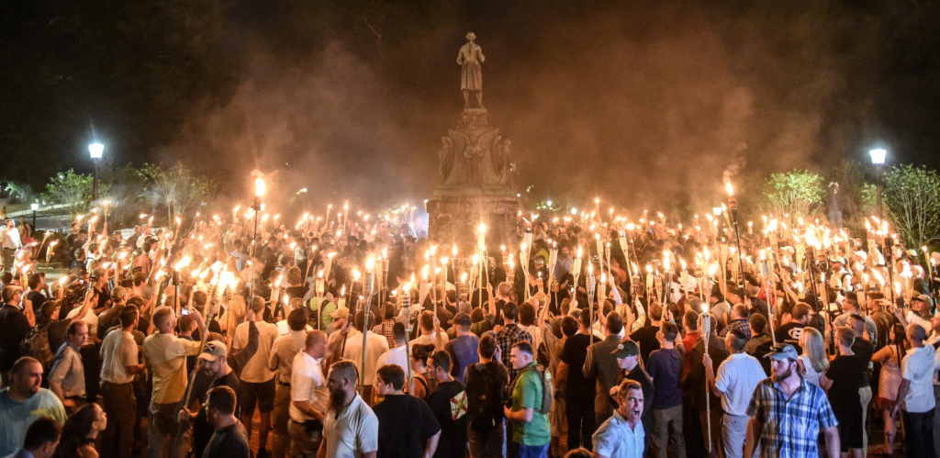
History 246: After the American Civil War: Race, Reconstruction, & Reconciliation
MW 4:00-5:15 &
F 1:00-1:50
Professor Ponce
This course investigates the aftermath of the American Civil War with an emphasis on race, reconstruction, and reconciliation. Topics include emancipation; the 13th, 14th, and 15th amendments; the Freedman’s Bureau; the rise of the Ku Klux Klan; the development of the lost cause ideology; voting laws and civil rights; the rise of Jim Crow laws; the epidemic of lynching; the contested election of 1877; and how the memory of the war shapes race relations.

Slide 15
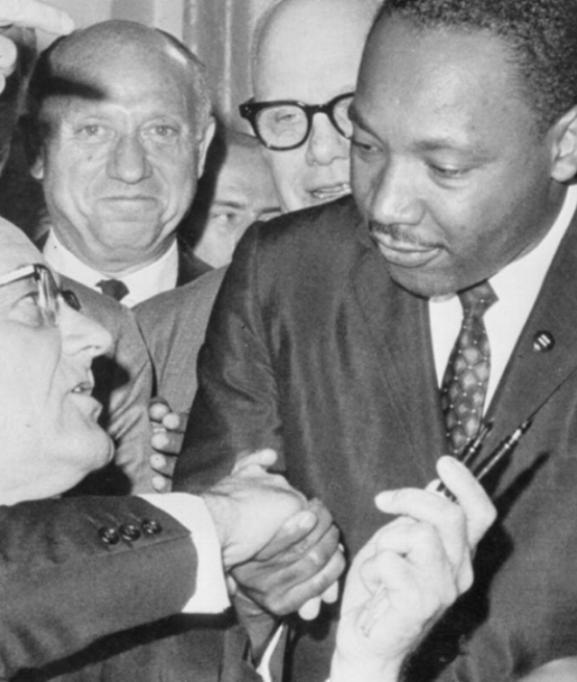

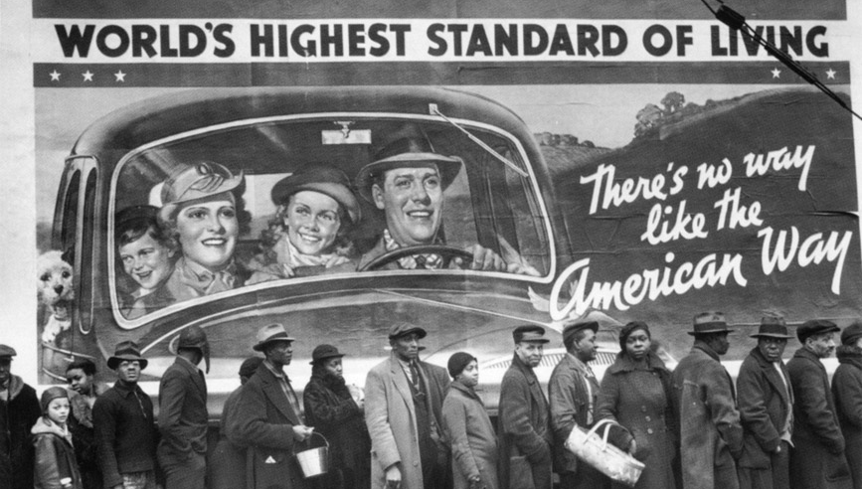
This course explores major issues that led to the making of the modern United States. It pays attention to social and intellectual currents, labor and business, immigration and ethnicity, race and gender, the development of reform and radical activities, war, Progressivism and the New Deal, women’s liberation and civil rights (Diversity)
History 112: Building Modern America (US History since 1877)
Prof. Michael Smith
TR 8:00 am – 9:15 am
HIST 112: US History since 1877
Prof. Smith MW 4-5:15

Slide 16
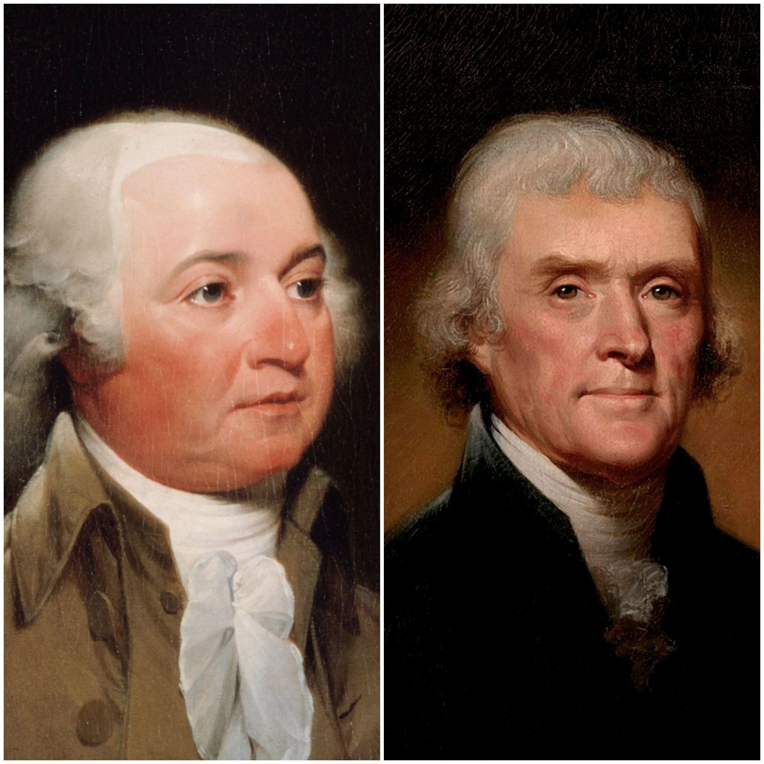

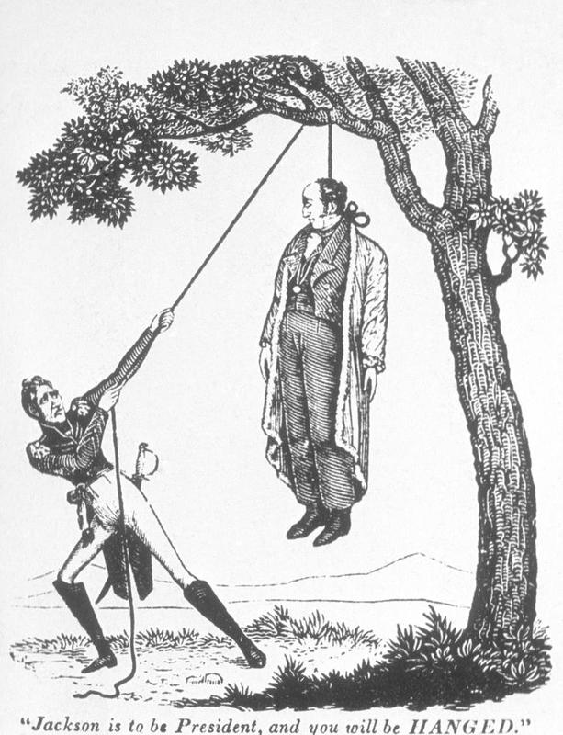
HIST 177
U.S. Elections in Historical Context:
Presidential
(1 cr.: Thursdays, 2:35-3:50 through early November)
Principal Course Goal:
To better understand the historical roots of contemporary politics (including parties, controversial elections in the past, voting rights, and campaigning)

Slide 17
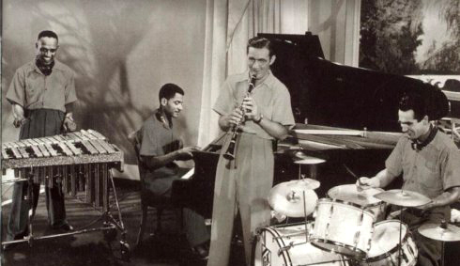
History 275 Professor Trotti
MWF 10:00 – 10:50 am &
R 10:50-11:40 am
History of U.S. Popular Culture. Starting with the novel and ending with the iPhone, we sweep through the history of American popular culture.

Slide 18

History 106
Prof. Zenon Wasyliw
MWF 3:00 – 4:10 or 1:00-2:10
History in the News: Global Identities and the Search for Justice
Introduces the field of contemporary history through an examination of current events and issues. Students follow international developments and offer historical contexts and evaluations within themes of global identities and the search for justice through the paradigm of globalization and human rights.

Slide 19
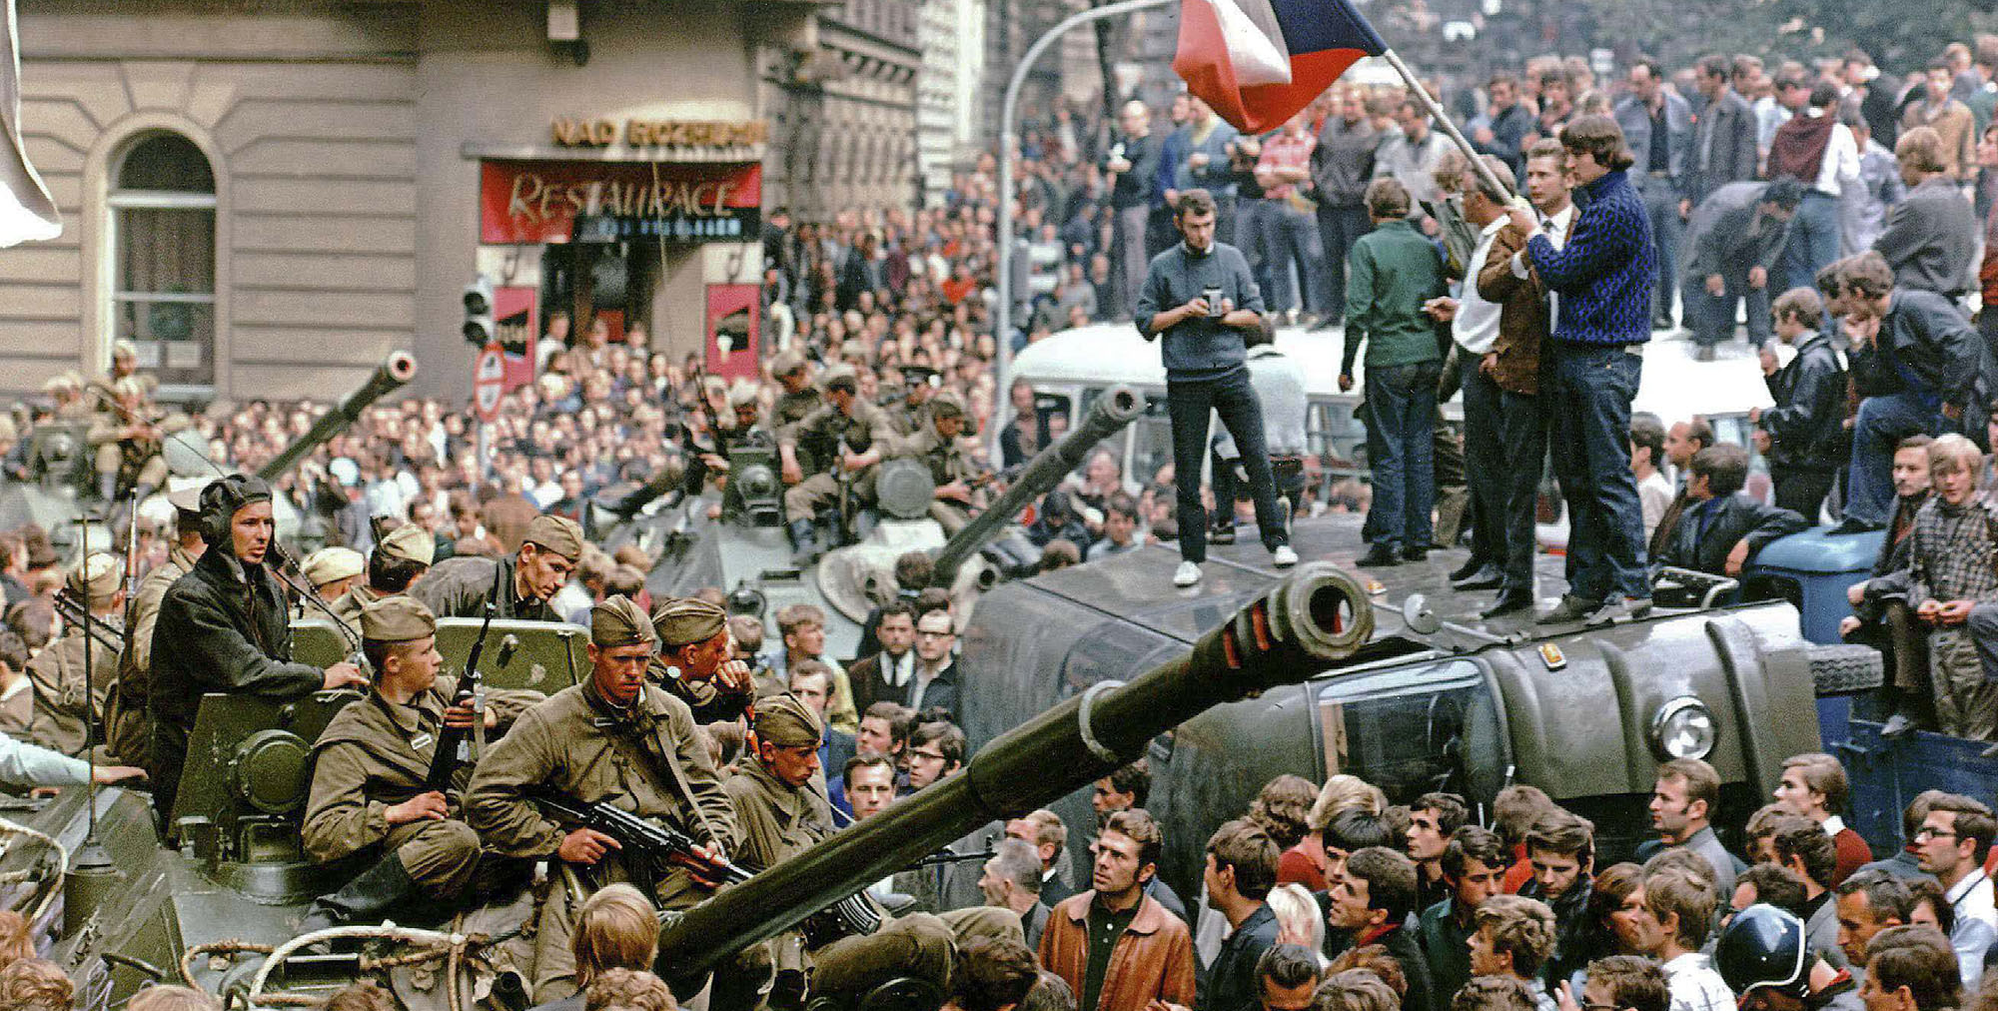
The Other Europe: Modern Eastern and Central Europe. Prof. Z. Wasyliw
TR 9:25 – 11:05 am
T

