Slide 1
History Courses
Spring 2025

Slide 2
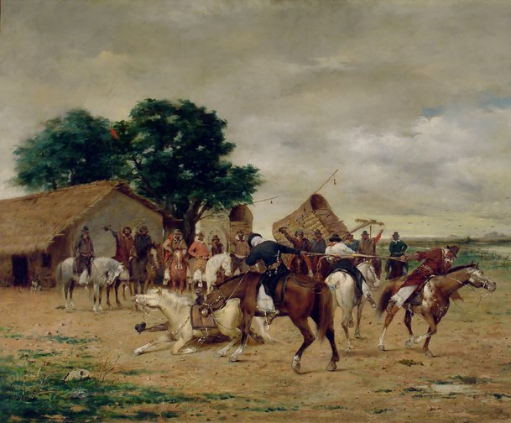
Modern Latin America (HIST 234) TR 2:35 – 4:15 pm Prof. Jonathan Ablard

Slide 3
HIST 20001: 1 Credit
History Slow Read: Doppelganger: A Trip into the Mirror World
Wednesday 1:00-1:50pm
Professor Jonathan Ablard

Slide 4
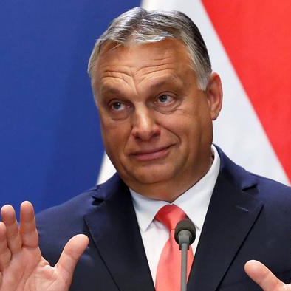
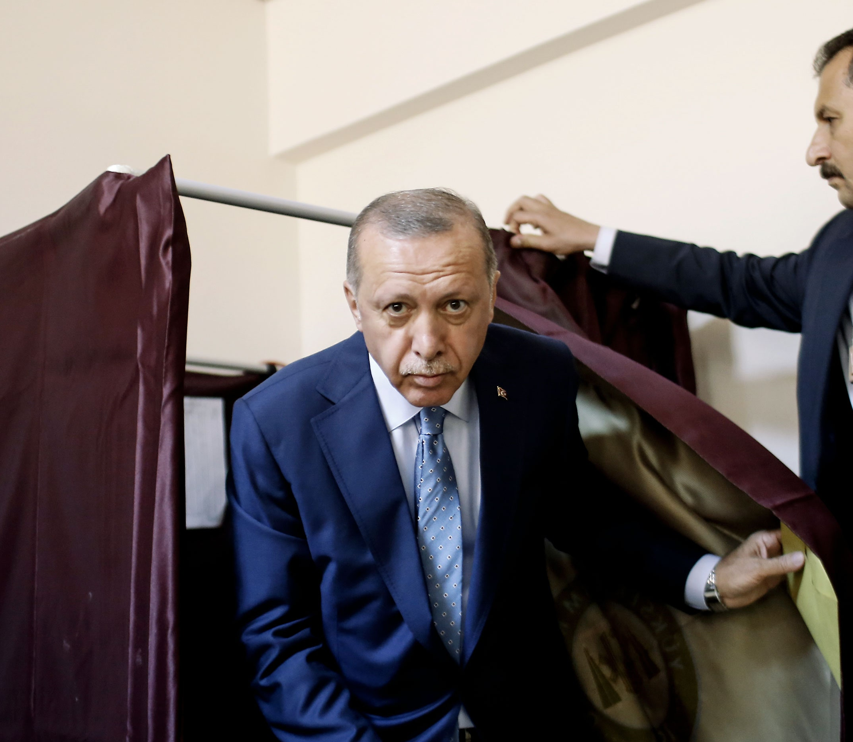
History 380 A Global History of Lies Professor Ablard MW 4:00-5:40 pm
Considers how a confluence of technological, economic, political and social forces have reshaped the contours and possibilities of misinformation and disinformation and their role in the development of rumors, conspiracy theories, and hoaxes. Focusing on Europe, the United States, and Latin America, we will trace the arc of conspiratorial thinking and rumors from the European Wars of Religion to the era of Trump, Putin, Bolsonaro, Orban, and Erdogan. This course counts toward the global requirement for department majors.

Slide 5
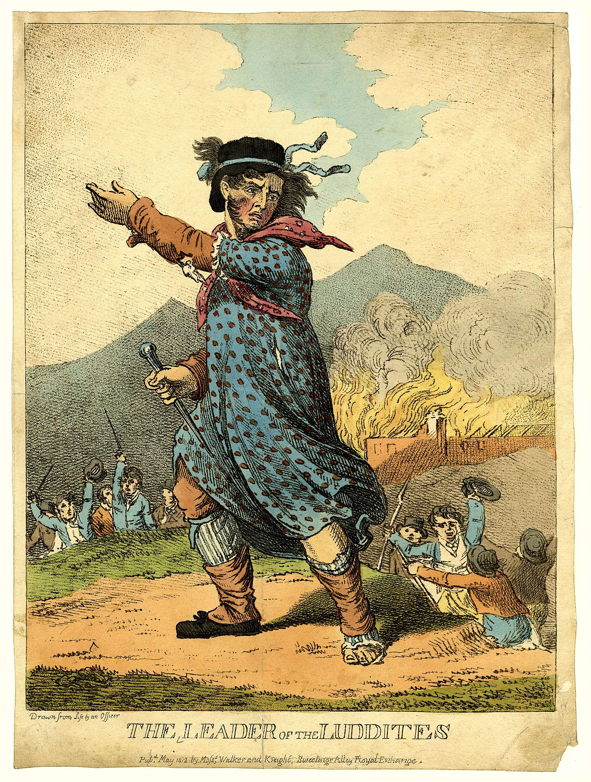
History 141 From the Margins: European Social History, 1400-1945 Prof. Karin Breuer MWF 11:00-12:10
This course traces the history of minority and marginal groups in Europe from the Renaissance to the end of the Second World War. It carries a diversity designation for the ICC.

Slide 6
HIST 28200: Democracies and Dictatorships in Twentieth Century Europe MWF 2:00-3:10 p.m. Professor Karin Breuer

Slide 7
History 182 Making of The Modern World TR 1:10-2:25 pm & W 12:00-12:50 pm Prof. Jason Freitag
This class starts roughly at 1500 and moves through to the present day. We will examine the rise of great empires in the Middle East and Asia (Ottoman, Mughal) and their relationship to the emerging European global powers. We will then examine the rise of European empires, beginning with the Spanish and Portuguese, and continuing through the Dutch, English and French imperial formations. Special consideration will be given to the encounters with indigenous populations in the Americas, Africa, and Asia, and the rise of independence and nationalist movements across the globe. Finally, we will consider the post-colonial world, the Cold War, the process of "globalization" and the conflicts and relationships that shape our world today.

Slide 8
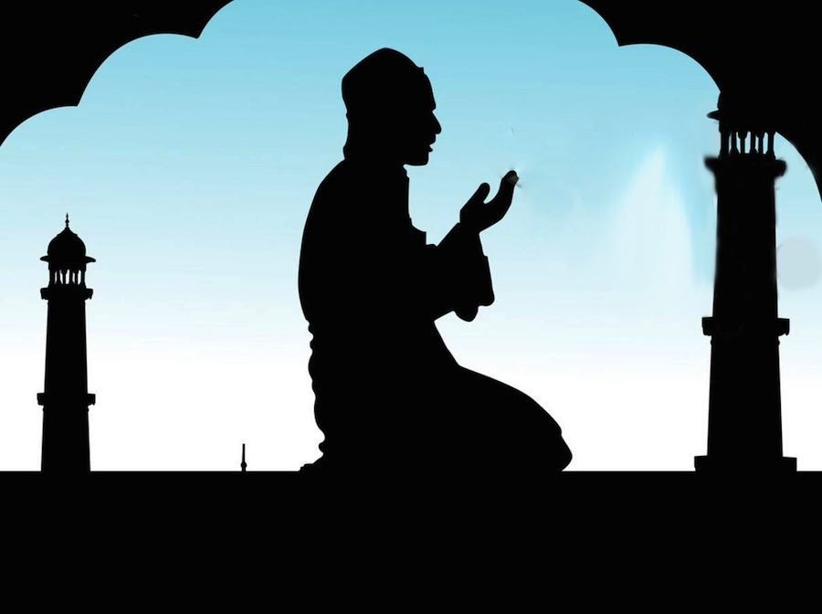
History 228 Islam in the Modern World Professor Jason Freitag TR 4:00-5:40 pm
This course presents an overview of the modern Islamic world, including the decline of the Ottoman Empire, European colonialism in Muslim lands, the rise of nationalism and nation-states in the Middle East and Islamic Asia, the Arab-Israeli conflict, the partition of India, the Islamic revolution in Iran, and the Gulf wars in Iraq.

Slide 9
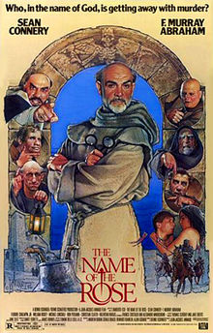
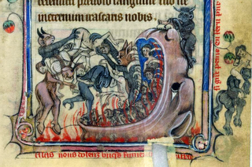
HIST 352: Monks, Heretics, and Scholars
Prof. Matt Klemm
TR 9:25-10:40 am & F 12:00-12:50 pm
This course examines cultural changes in Europe from the 12th to early 14th centuries. This was a period of great achievement, ambition, and growth, witnessing the creation of universities, stable monarchies, gothic art and architecture, and new habits of thinking about the natural and supernatural worlds. We will use the novel, The Name of the Rose, to help guide the course.

Slide 10
HIST 231: Body & Society in Ancient Greece & Rome TR 1:10 - 2:25 pm & F 1:00 - 1:50 pm Professor Matt Klemm

Slide 11
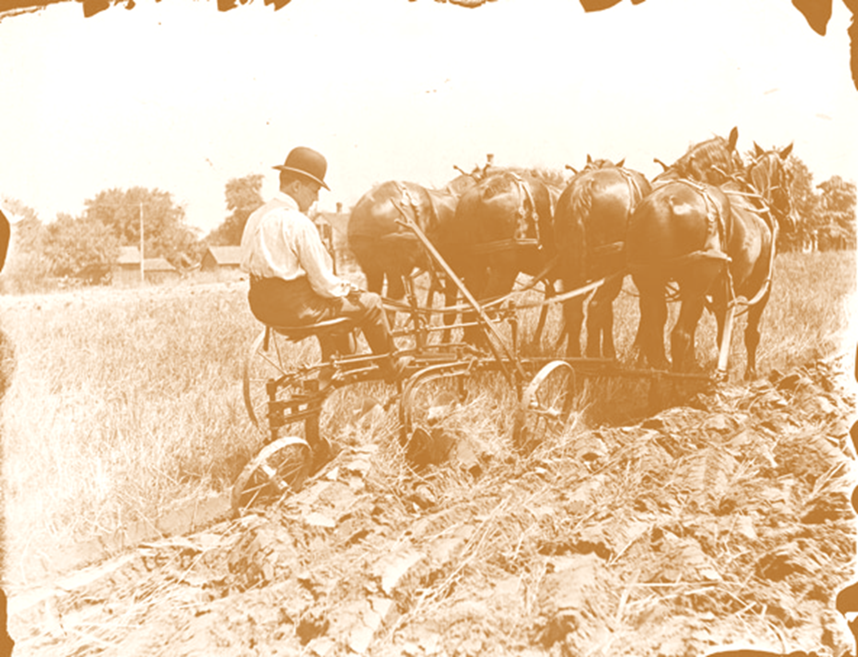
HIST 270—History of American Environmental Thought
Michael Smith
TR 10:50 am-12:05 pm
F 9:00 – 9:50 am
4 Credits
Environmental History—What Is It?: illuminate the interplay between human history and natural history, examining many of the permutations of “nature’s role in American history.”
Cultural Constructions of Nature: illuminate the ways in which Americans’ thinking about nature and the environment has changed during the past several centuries, exploring the ways Americans have projected human values onto nature; e.g., why some people have described the forests as sanctuaries and others have described them as “board feet.”
Doing History: how do historians look at sources from the past (including the landscape) and use them to tell a story that both makes sense and is well-supported by the sources. The course includes an extended archival research project at the History Center in Tompkins County.
Course Format: Reading, discussion, some lecture, several papers, local environmental history research project.

Slide 12
History 168: 1968, a U.S. Revolution MWF 9-9:50 am
Prof. Michael Trotti
A tour of the most tumultuous year of a transformative era:
turning points in Vietnam and in Civil Rights;
the heyday of the counterculture; and
plus a race to the moon!
Explore the year when “Law and Order” shared the stage with “Yippies” putting a pig forward for the Presidency.

Slide 13
History 307 Prof. Trotti MWF 3:00-3:50 pm & M 12:00-12:50 pm
The U.S. in the Age of Global Crisis, 1914-45
WWI;
"Roarin'" 1920s;
Great Depression; and
WWII.
America was transformed in this era, hardly more than a generation

Slide 14
History 106 Prof. Zenon Wasyliw MW 1:00 – 2:15 & F 1:00-1:50
History in the News: Global Identities and the Search for Justice
Introduces the field of contemporary history through an examination of current events and issues. Students follow international developments and offer historical contexts and evaluations within themes of global identities and the search for justice through the paradigm of globalization and human rights.

Slide 15
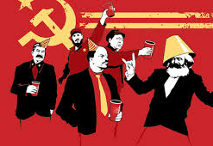
An exploration of ideas, concepts, and backgrounds of world revolutions in the 20th and 21st centuries. Applying various models of revolution in Europe, Asia, Africa, and the Americas.
HIST 273 Global Revolutions in the 20th-21st Centuries
Prof. Zenon Wasyliw
MW 10:00-11:15 am & F 10:00-10:50 am

